Slide 1
Netflix Movies and TV Shows Clustering using Unsupervised Machine Learning

Slide 2
Problem Statement
Netflix contains thousands of movies and TV shows with different genres, ratings, release years, and descriptions. Since this data does not have predefined labels, identifying similar content manually is difficult.
This project applies unsupervised machine learning techniques to automatically group similar content into meaningful clusters, helping improve content organization and recommendation systems.
Netflix Dataset
↓
Data Cleaning
↓
Clustering
↓
Business Insights

Slide 3
Objectives
Analyze the Netflix dataset.
Perform data cleaning and preprocessing.
Explore the dataset using visualization.
Build clustering models.
Compare K-Means, Hierarchical Clustering, and DBSCAN.
Select the best clustering algorithm.
Generate business insights.

Slide 4
Dataset Description
Attribute | Value
Dataset | Netflix Movies & TV Shows
Records | 7,787
Columns | 12
Important Features Type Director Country Rating Duration Listed_in (Genre) Description

Slide 5
Data Cleaning
Steps Performed
✔ Removed duplicate records
✔ Handled missing values
✔ Converted date columns
✔ Extracted
Year Added
Month Added
Day Added
✔ Created
Content Age
Genre Count
Duration (Numeric)

Slide 6
Feature Engineering
Features Created
One-Hot Encoding
TF-IDF for Genres
TF-IDF for Description
StandardScaler
Text
↓
TF-IDF
↓
Numerical Features
↓
Machine Learning

Slide 7
Clustering Algorithms
Algorithm | Description | Advantages | Limitations
K-Means | Centroid-based clustering that partitions data into K groups by minimizing the distance between data points and cluster centroids. | Fast, simple, efficient for large datasets. | Requires specifying the number of clusters (K), sensitive to outliers, assumes spherical clusters.
Hierarchical Clustering | Tree-based clustering that builds a hierarchy of clusters represented by a dendrogram. | Does not require specifying the number of clusters initially, easy to visualize relationships. | Computationally expensive for large datasets, slower than K-Means.
DBSCAN | Density-based clustering that groups closely packed points and identifies sparse regions as noise or outliers. | Can detect clusters of arbitrary shapes, identifies outliers automatically. | Sensitive to parameter selection (eps and min_samples), struggles with datasets having varying densities.

Slide 8
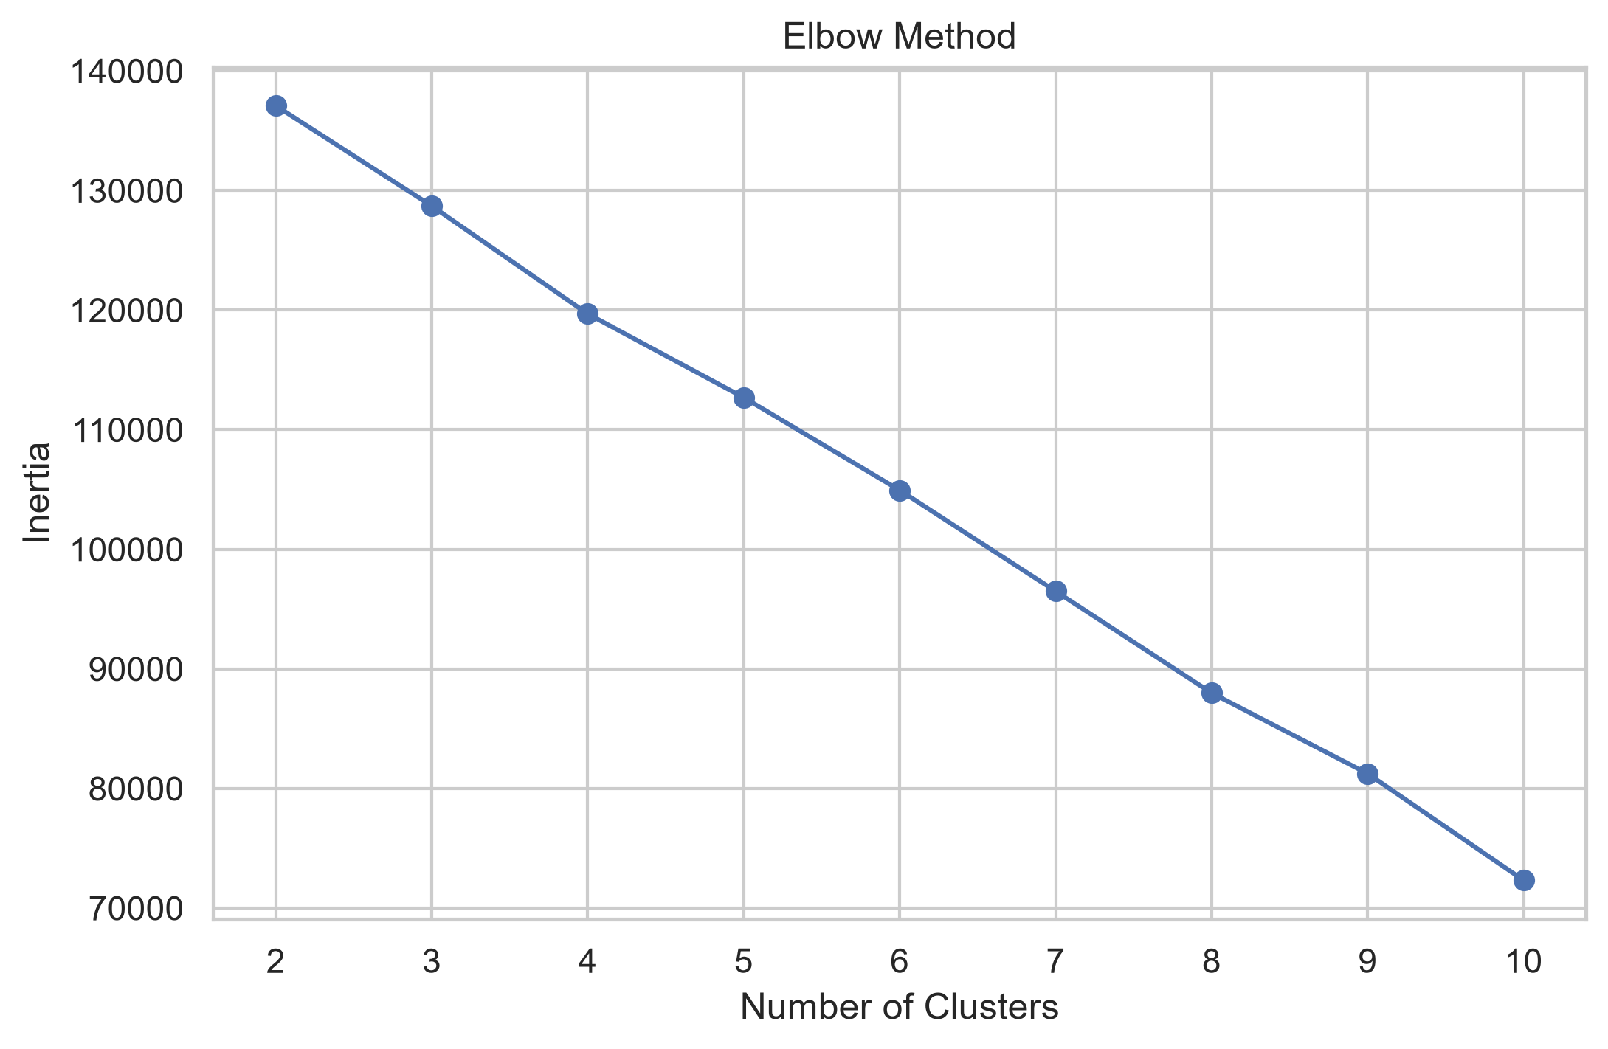
K-Means Results

Slide 9
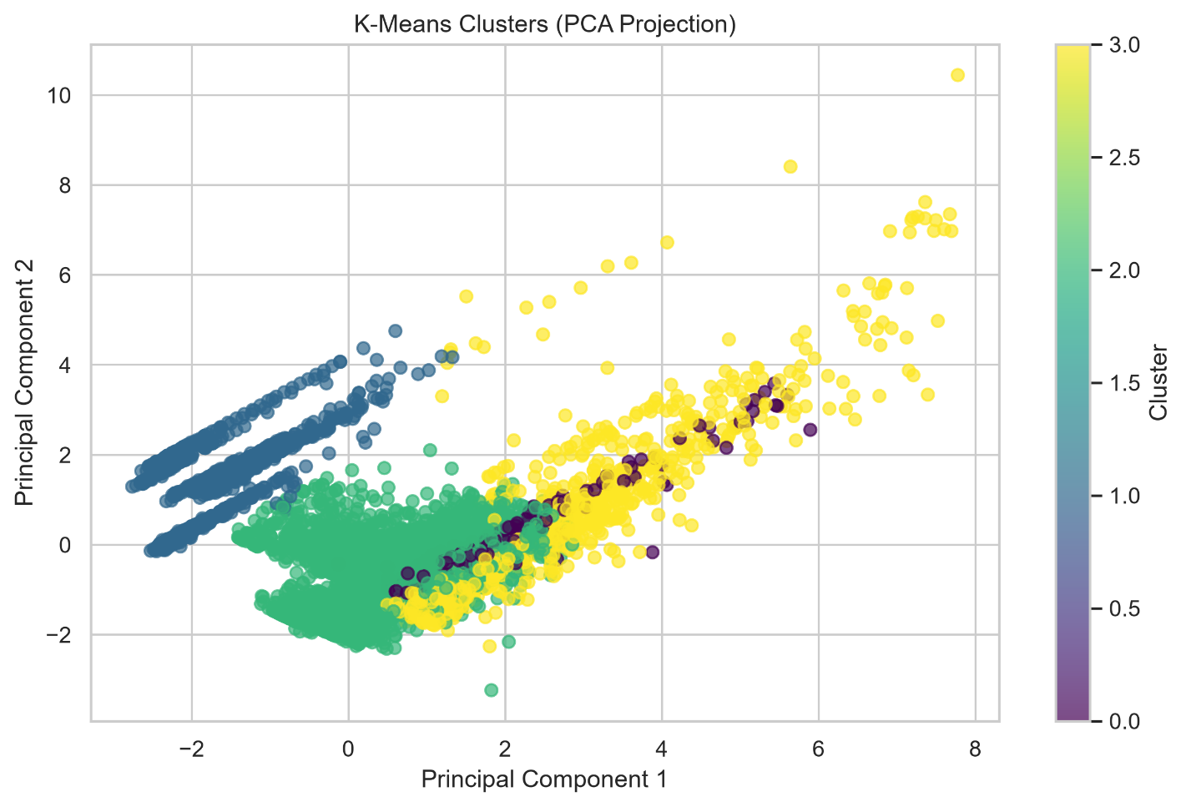
Results
Silhouette Score:0.1931
Davies-Bouldin Index:1.8205

Slide 10
Algorithm Comparison
Algorithm | Silhouette | DB Index
K-Means | 0.1931 | 1.8205
Hierarchical | 0.1648 | 2.2096
DBSCAN | 0.1189 | 1.6799

Slide 11
Business Insights
Key Insights
Similar Netflix content was grouped successfully.
Drama and International Movies dominate.
Movies outnumber TV Shows.
Clustering improves recommendation quality.
Helps identify content trends.

Slide 12
Conclusion
Successfully analyzed and clustered 7,787 Netflix movies and TV shows using unsupervised machine learning techniques.
Performed comprehensive data cleaning, exploratory data analysis, feature engineering, TF-IDF vectorization, and feature scaling to prepare the dataset for clustering.
Implemented and compared K-Means, Hierarchical Clustering, and DBSCAN using the Silhouette Score and Davies-Bouldin Index.
K-Means was selected as the best-performing algorithm as it achieved the highest Silhouette Score, indicating better cluster quality for this dataset.
The resulting clusters revealed meaningful patterns in Netflix content based on genres, ratings, release years, durations, and descriptions.
These insights can help enhance recommendation systems, improve content categorization, support personalized user experiences, and assist Netflix in making informed business and content strategy decisions.
This project demonstrates how unsupervised machine learning can effectively extract valuable insights from large, unlabeled datasets and can serve as a foundation for developing intelligent content recommendation systems in the future.

